Slide 1
A few notes on Spring
Panos Vassiliadis

Slide 2
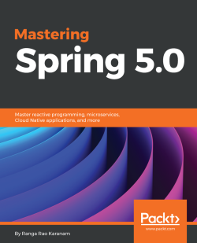
Based on…
Mastering Spring 5.0
by Ranga Karanam
Packt, June 2017
ISBN: 9781787123175
https://www.packtpub.com/product/mastering-spring-5-0/9781787123175
https://github.com/packtpublishing/mastering-spring-5.0

Slide 3

https://spring.io/why-spring

Slide 4
Why Spring?
Spring framework is a Java framework with the intent to …
… alleviate the developer from the burden of managing the creation of objects,
… and, instead, …
… focus to the business logic of the system being built

Slide 5
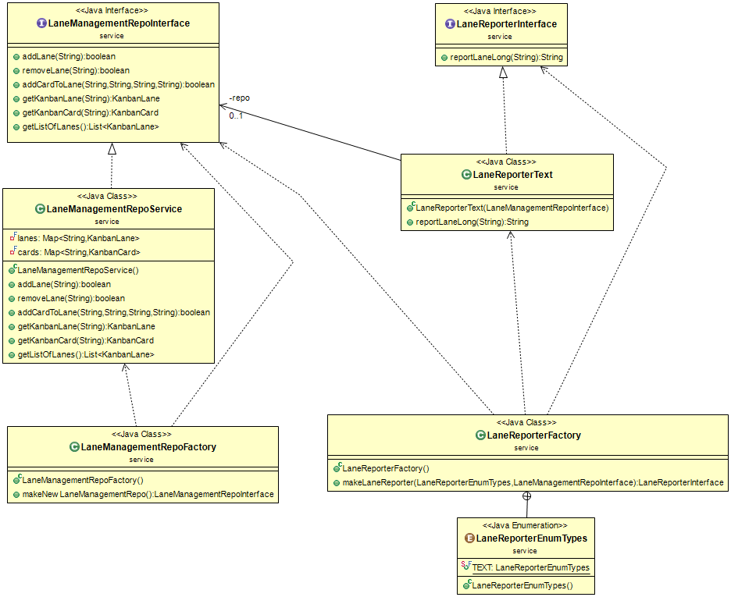
Traditional object creation via factories …
https://github.com/pvassil/00_KanbanLanes_NakedInTheRain

Slide 6
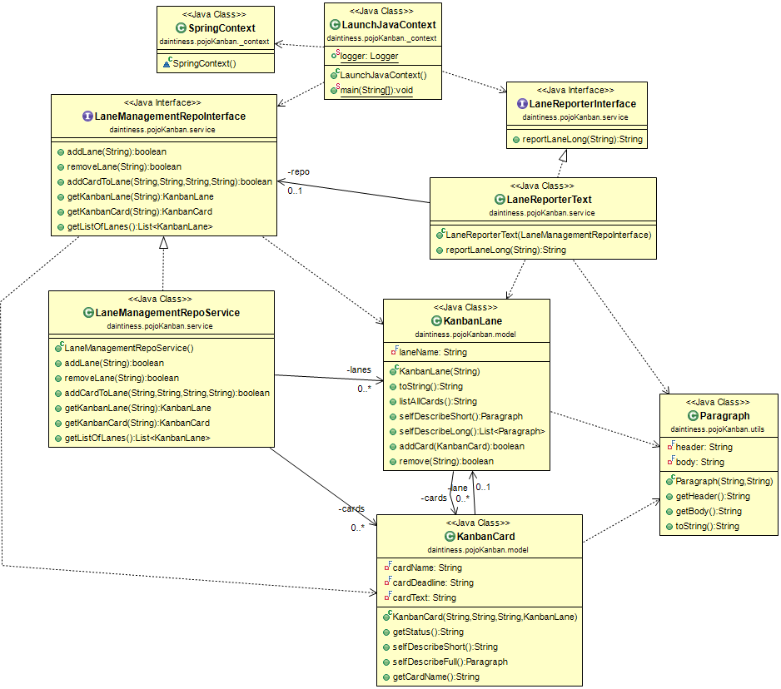
With Spring…
https://github.com/pvassil/01_KanbanLanes_SpringOnly

Slide 7
Dependency Inversion and Injection
Dependency Inversion Principle (DIP): Clients and high-level modules should depend on abstractions (rather than concrete classes)
Dependency Injection: a composite class does NOT create its components (does not deal with instance management), but rather, we pass ready-made components to it, upon the invocation of its constructors (“someone else builds your components and injects them into your structure at your creation”)
Inversion of Control: the classes that we write, receive “instructions” (“control”) from the framework we use

Slide 8
Dependency injection at Spring
Done via:
Spring beans: business logic objects, created “in the shades” by Spring (instead of explicitly creating them with our code)
Autowiring: instructing Spring how to perform the creation of the objects

Slide 9
Inversion of control for object injection in Spring, via annotations
@Repository
@Qualifier("LaneManagementRepoService")
class LaneManagementRepoService implements LaneManagementRepoInterface
@Service
@Qualifier("LaneReporterText")
class LaneReporterText implements LaneReporterInterface {
private final LaneManagementRepoInterface repo;
@Autowired
public LaneReporterText(@Qualifier("LaneManagementRepoService") LaneManagementRepoInterface repo) throws NullPointerException{
this.repo = Objects.requireNonNull(repo);
}
…
}

Slide 10
Inversion of control for object injection in Spring, via annotations
@Configuration
@ComponentScan(basePackages = { "daintiness.pojoKanban" })
class SpringContext {
}
public class LaunchJavaContext {
public static void main(String[] args) {
ApplicationContext context = new AnnotationConfigApplicationContext(
SpringContext.class);
LaneManagementRepoInterface repo = context.getBean(LaneManagementRepoInterface.class);
…
LaneReporterInterface textReporter = context.getBean(LaneReporterInterface.class);
…
((ConfigurableApplicationContext)context ).close();
}
}

Slide 11
You also need …
The correct pom to configure the maven environment for your project
A few setup configurations in Eclipse
See:
The github of the project https://github.com/pvassil/01_KanbanLanes_SpringOnly
The respective video (Video #6) https://youtu.be/C6Q1r3l3R1k

